Slide 1
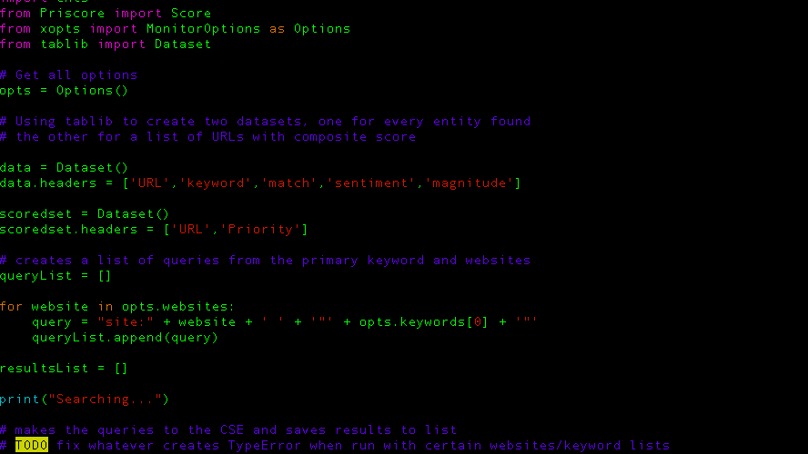

PYTHON FOR OSINT
Automating your osint collection using python libraries
By emily chance and Ayelet Glaser

Slide 2



About Emily
OSINT consultant in the Los Angeles Area
Specializes in doing threat assessments and other OSINT gathering for SMBs and private clients
Self-taught python developer
Defcon562 member
Can be found on Twitter at @g_solaria
Probably a bit too obsessed with dogs

Slide 3
About Ayelet Glaser
Based in France
Freelance python and database dev
10 years of experience with a focus on making tools for scientific research.
Available for freelance work (contact Emily for info)
Conversely, obsessive cat mom to Squeaker and Potato

Slide 4
Purpose of this talk
This talk will cover several python libraries that can be used to automate Open Source Intelligence (OSINT) gathering.
This talk assumes that you already are familiar with OSINT, and that you have some experience writing python.
We will walk through the libraries and show examples of programs that use them.
Programs can be found online at https://github.com/g-solaria/ShellCon2018
Programs are written in python 3 like the good lord intended.
Some code examples may not run on their own because they are meant to demonstrate one specific concept.

Slide 5
Libraries Covered
Google Custom Search API (https://developers.google.com/custom-search/)
Beautiful Soup (https://www.crummy.com/software/BeautifulSoup/)
Google Cloud Language API (https://cloud.google.com/natural-language/)
Fuzzywuzzy (https://github.com/seatgeek/fuzzywuzzy)
Selenium (https://www.seleniumhq.org/)

Slide 6
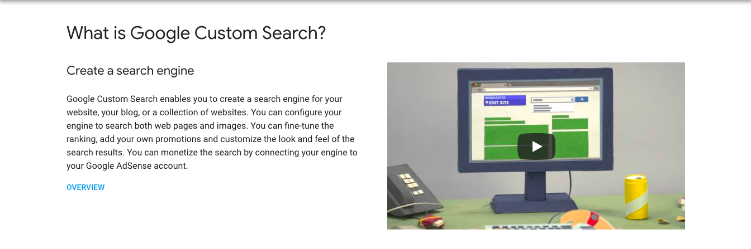
Google custom search api
Google provides the ability to create custom search engines that hit specific domains.
This is restrictive in that we can only look at the domains we’ve specified when creating the CSE.
Workaround – go back in and remove those domains, and we now have an API for all of Google.

Slide 7
Creating a CSE
To create a new Google Custom Search Engine, go to https://cse.google.com/cse/all
Click “add” and fill out the information.
Note that it will ask you specify a domain you want to search. We will delete this later.
Click Create, then on the next page, click Control Panel.
Select the domain you added, and click delete. You now have an API for Google.
Up to 100 searches per day for free. Searches are $5 per 1000 after that, up to 10,000/day.
Creating a new Google Cloud billing account gives you $300 in credit – you’ll just need to change your api key and cse ID.
Install library using pip:
pip install --upgrade google-api-python-client

Slide 8
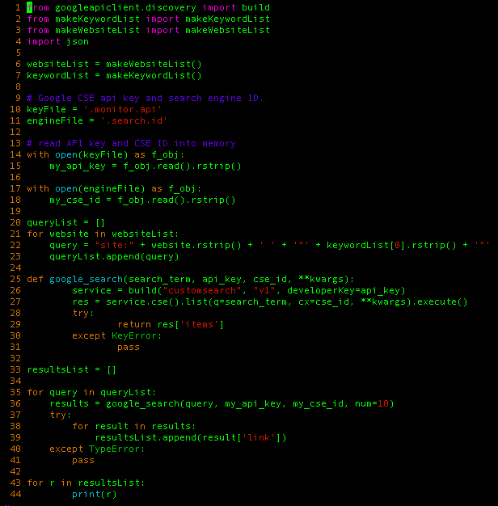
Notes:
Discuss google_search() function, line 25, and for loop at line 35 where function is called.

Slide 9

Beautiful Soup
HTML parsing library.
Creates a “Beautiful Soup” object that maintains the structure of the page and can be worked with in multiple ways.
Allows you to select portions of text from a page based on tags, classes, etc.
Allows you to find() or find_all() for locating specific words or phrases within sections of the page.
Install using pip:
pip install bs4

Slide 10
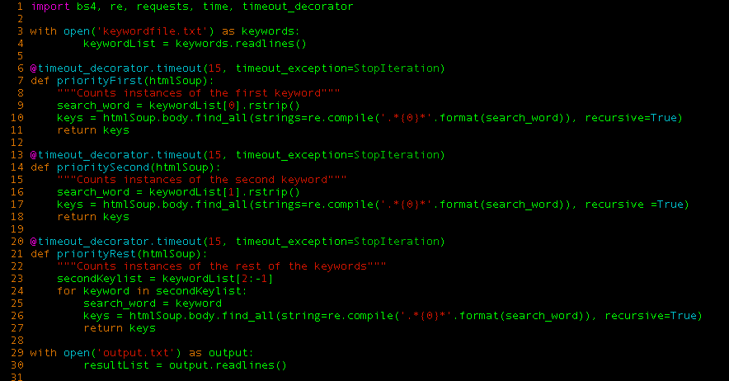
Notes:
Discuss how to create BS object, and the “find_all()” function

Slide 11
Google Cloud Language API
Can be created using the same account as the CSE API.
Installed via pip
pip install google-cloud-language
Gives you a JSON file containing your credentials, which must be exported to your environment
export GOOGLE_APPLICATION_CREDENTIALS=‘credential-doc.json’
Allows for analysis of documents to find entities, sentiment, and sentiment about entities.
There is a cost to the API calls, but as with the CSE api, creating new accounts will get you $300 credit.

Slide 12
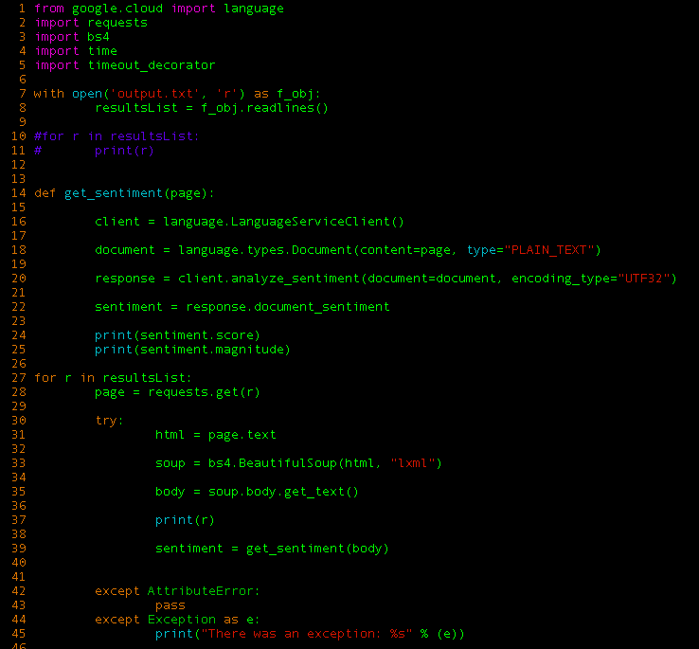

Slide 13
FuzzyWuzzy
Uses to compare for similarities between words or phrases.
Can be used to identify keywords in a page that may have been misspelled, etc.
Uses Levenshtein distance to compare words or phrases.
Levenshtein distance is a string metric for measuring the difference between two sequences. Informally, the Levenshtein distance between two words is the minimum number of single-character edits (insertions, deletions or substitutions) required to change one word into the other.
Installed via pip:
pip install fuzzywuzzy[speedup]

Slide 14
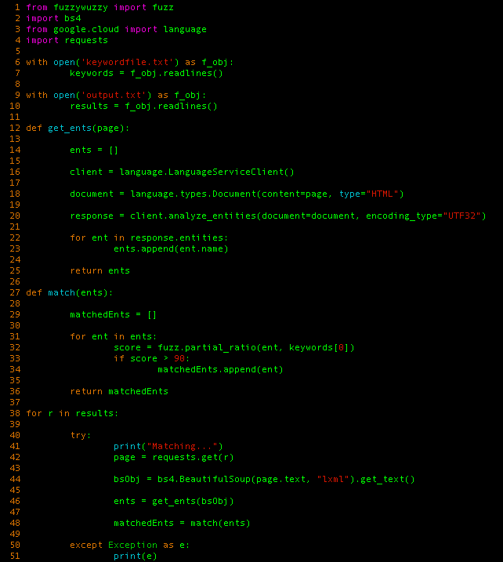

Slide 15
Selenium
Emulates a web browser.
Can be used to do things like log into websites.
Allows you to use different browsers, including headless chrome.
Installed via pip:
pip install selenium.
Can be passed credentials to log into websites, handle cookies, and take screenshots.

Slide 16
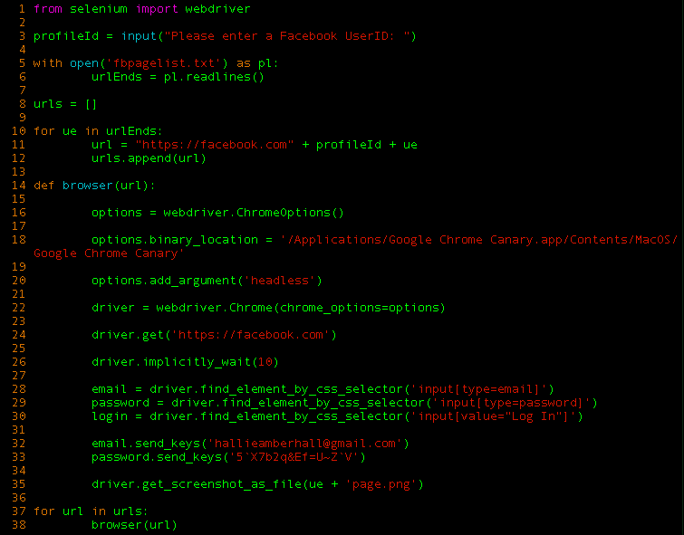

Slide 17
Xonitor
Xonitor (re-written from the original by Ayelet) combines elements of the first four libraries (Selenium support for logging in to sites and screenshotting results to be added).
Allows input of keywords and websites to search.
Uses CSE to find results, Cloud Language API get entity sentiments, and keyword weighting to come up with a priority score.
Can be used to monitor results and prioritize them based on keyword concentration and the various entities.
Run as cron job to monitor results consistently.
Open Sourced at (repo url)

Slide 18
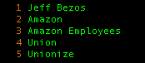
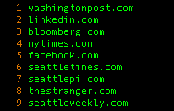
keys.txt
sites.txt

Slide 19
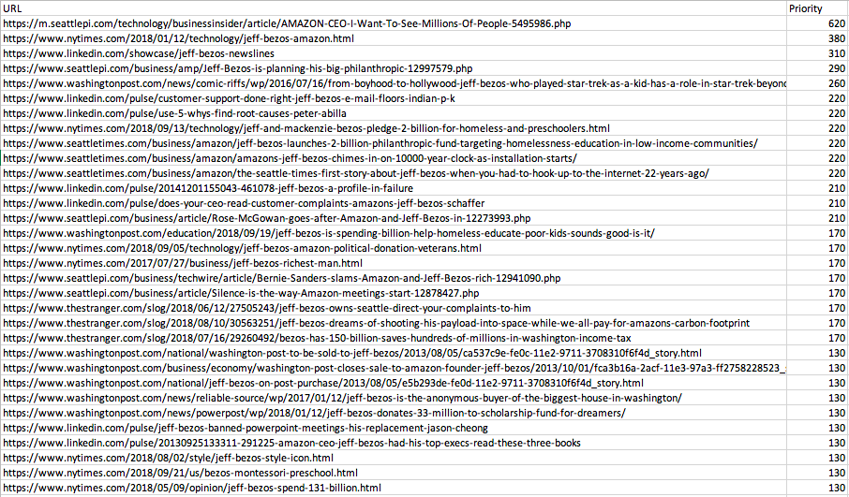
Notes:
triage

Slide 20
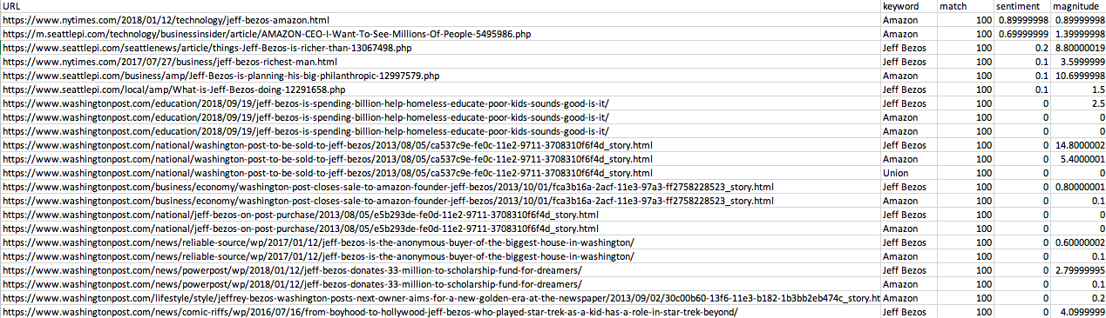
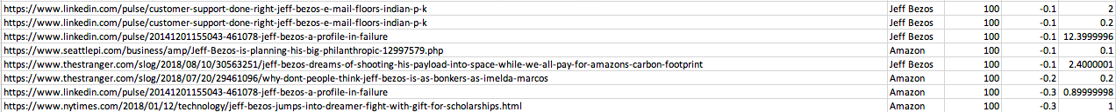

Slide 21
Potential Uses
Monitor the online sentiment about product, person, event.
Monitor for potential data leaks containing sensitive keywords.
Automate portions of on-going OSINT gathering.

Slide 22
TODO
Implement selenium to add support for logging into websites (social media, news sites, etc)
Tracking results across time to monitor the changes in sentiment automatically.
Community contributions?

Slide 23
QUESTIONS?

